Slide 1
TOTAL SOLAR ECLIPSE
8TH APRIL 2024
MEXICO

Slide 2
OVERVIEW
Purpose of Eclipse
Saros Cycle 139 N - 1501
8th April 2024 - Path of Umbra
Eclipse Window: Current World Events
Chart
Aries stellium
Esoteric Ruler – Mercury
Exoteric Ruler - Mars
Jupiter Uranus conjunction 1941 & 2024
Israel & World Events
Comet Pons Brook

Slide 3
Purpose of eclipse
3 year window
New Moon
Between Easter & Wesak
April 2024 – April 2027
Nations & Races
Global Leaders & Organizations
Cardinal Eclipse

Slide 4
FAMILY: Saros 139 N
15th May 1501 - iceland

Slide 5
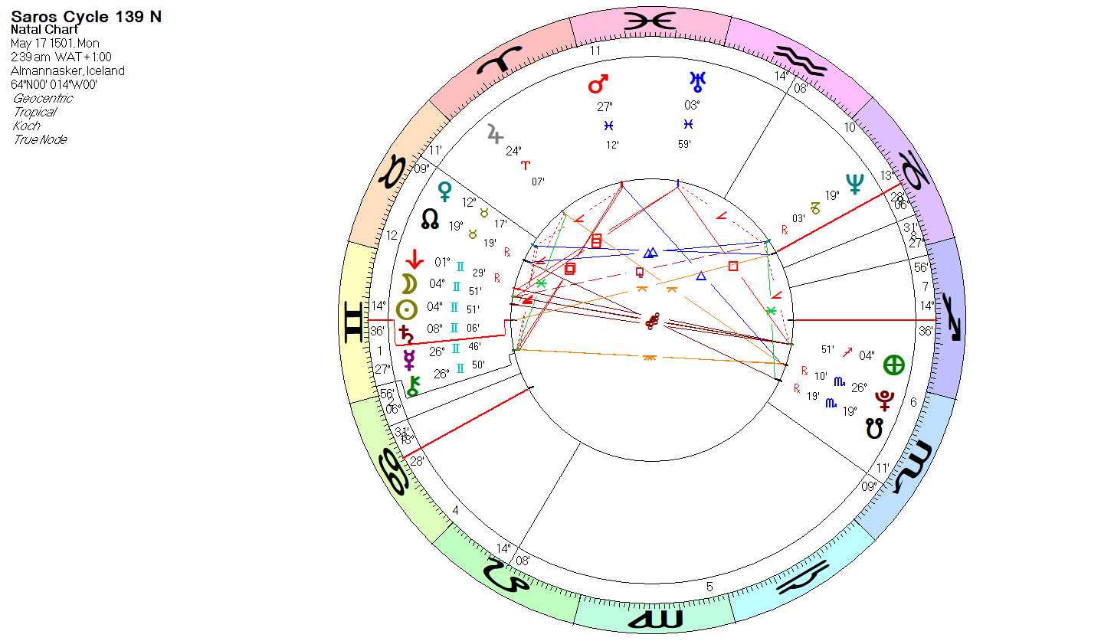

Slide 6
themes
Gemini stellium
Vulcan Sun Moon Saturn Gemini
Mars Pisces void square Mercury Gemini - ruler
Deception, confusion, propaganda, religious crusades
Sabian Symbol:
“A radical magazine displays a sensational front page.”

Slide 7
8TH APRIL 2024
Durango, MEXICO

Slide 8
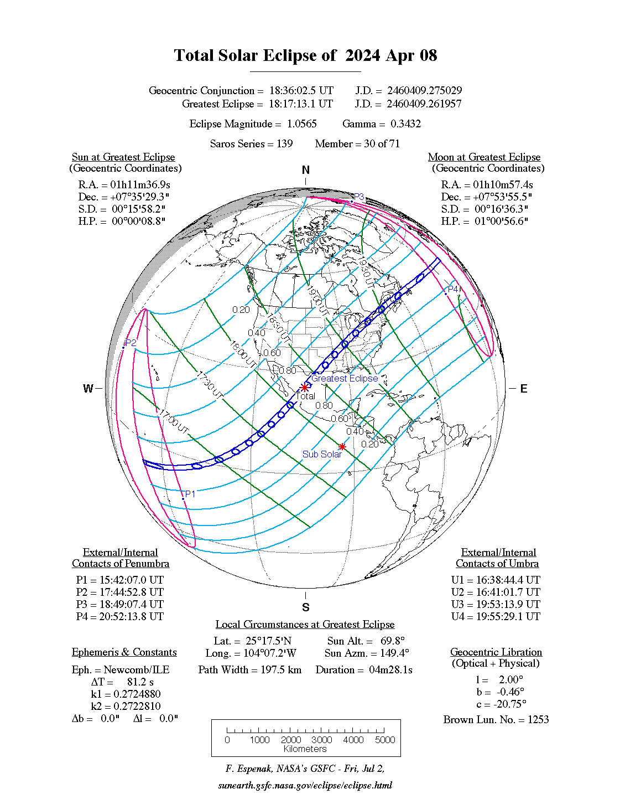

Slide 9
ECLIPSE WINDOW
18TH March – 29th April 2024

Slide 10
Current world events
Ukraine war - ongoing
Middle East War - ongoing
Space Travel – permanent base on the Moon
Global Economic crisis continues
Digital Economy cliff looms
Earthquake Taiwan
Upcoming USA election – Dec. 2024

Slide 11
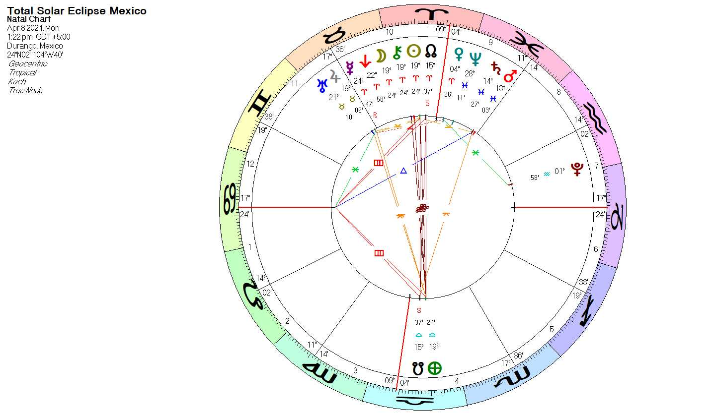

Slide 12
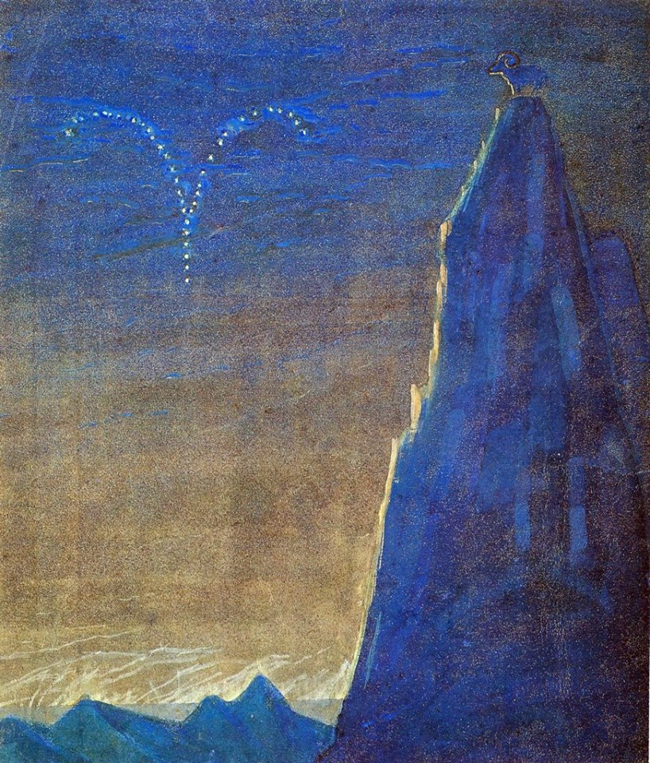
Aries stellium
Eclipse conjunct Chiron in Aries
North Node Aries cross quarters
Nodal Angular Grand Cross – Cancer Ascendant
Ruler - Mars Conjunct Saturn in Pisces
Sabian Symbol: A young girl feeding birds in winter

Slide 13
Aries countries
Europe
Iceland England Wales Denmark
France Germany Poland Portugal
Spain Lithuania
Africa
Northern Sudan
Middle East
Israel, Syria. and Iran
Asia - Japan
South Pacific - New Zealand

Slide 14
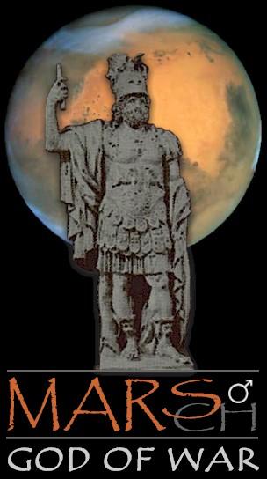
Exoteric ruler
Mars in Pisces conjunct Saturn
Semi –square Pluto
“A lady in a fox fur” Sabian symbol
Aries – 1st Ray
Pisces – Paths of Evolution divide

Slide 15
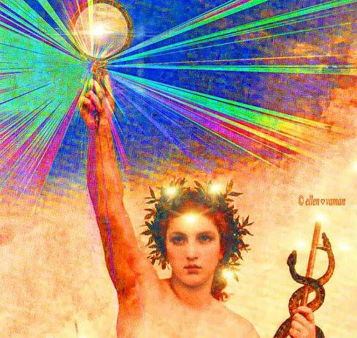
Esoteric ruler
Mercury in Aries , retrograde
“A double promise reveals its inner
and outer meaning.”

Slide 16
4th ray harmony through conflict
Mercury rules Aries – esoteric
Soul Ruler of Humanity
Hope springs eternal
Earth Changes - upheaval

Slide 17
esoteric
Mercury
Inner Balance, Inner Strength, Respectfulness
17 Steps to Perfection – Ananda Tara Shan

Slide 18
Jupiter Uranus conjunction
1941 & 2024

Slide 19
JUPITER URANUS CONJUNCTION IN TAURUS: 25th may 1941
WORLD EVENTS - WW2
Britain: The Blitz (September 7, 1940–May 11, 1941)
North Africa Theatre of War - 12th Feb 1941
Siege of Tobruk 10 April – 27 November 1941

Slide 20
OPERATION BARBAROSSA
22ND June 1941
Opening what will become the East Front
Bloodiest front of World War II
Massive German armies invade the Soviet Union

Slide 21
America enters the war
PEARL HARBOUR
7TH Dec, 1941
USA & Japan
Which led ultimately to Hiroshima & Nagasaki

Slide 22
Jupiter Uranus conjunction
2024

Slide 24
Jupiter & Uranus in taurus
Jupiter in Taurus
Spoils of war – land, power, commerce, money
Uranus: Sabian Symbol
“White dove over troubled waters”
Esoteric conjunction - Wisdom teachings

Slide 25
Israel & world events

Slide 26
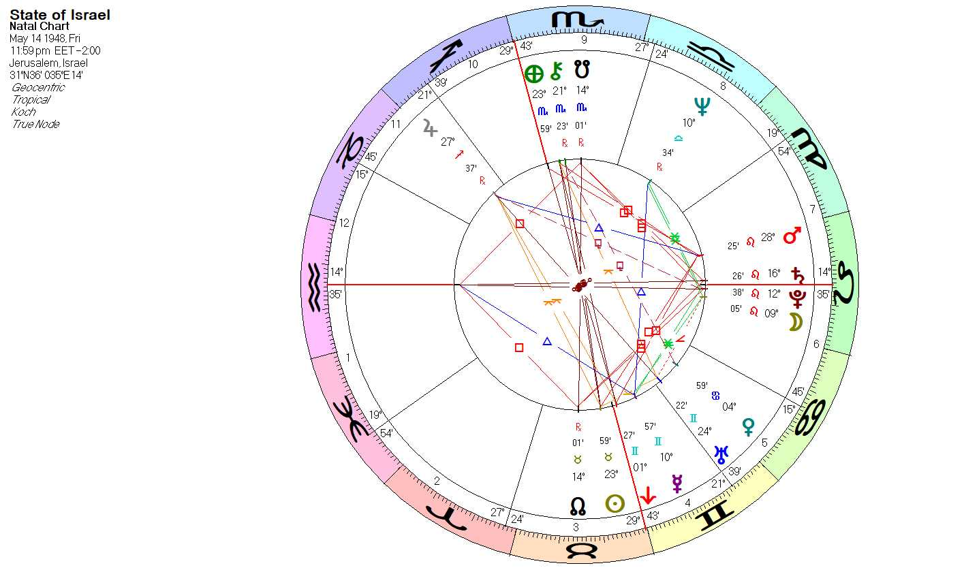

Slide 30
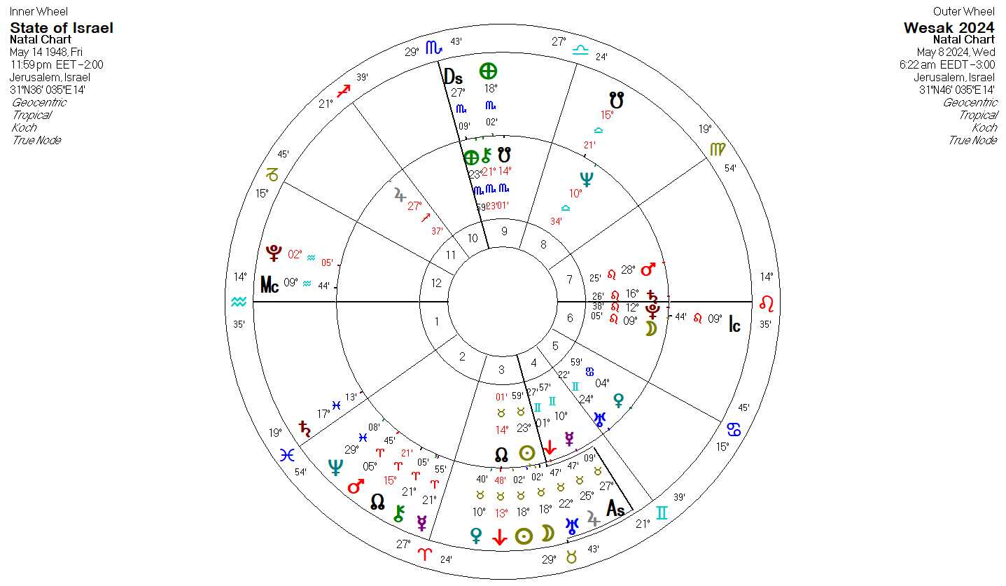

Slide 31
Comet Pons-brooks
Halley-type periodic comet that was first discovered by Jean-Louis Pons on July 12, 1812 and then independently rediscovered by William Robert Brooks in 1883. It has an orbital period of about 71.3 years.
Barely visible
240,934,993 kilometers from Earth.
. . . .1953
. . . .2024

Slide 32
references
https://eclipsewise.com/solar/SEsaros/SEsaros139.html
https://www.theosophicalfellowship.org/store/p37/The_17_Steps_to_Perfection_-_revised_edition.html
17 Steps to Perfection
http://starastrologyhealing.com
https://starastrologyhealing.com/esoteric-education/earths-great-change/2023-2/
Navigating the Way

